Slide 1
Chapter One Data Structures and Libraries
Linear DS with Built-in Libraries
Non-Linear DS with Built-in Libraries
Data Structures with Our Own Libraries

Slide 2
Non-Linear DS with Built-in Libraries
For some problems, linear storage is not the best way to organize data. With the efficient implementations of non-linear data structures shown below, you can operate on the data in a quicker fashion, thereby speeding up the algorithms that rely on them.
For example, (key → value pairs), using C++ STL map can provide you O(log n) performance for insertion/search/deletion operations
Non-Linear DS with Built-in Libraries
Balanced Binary Search Tree (BST): C++ STL map/set
Heap: C++ STL priority queue
Hash Table: C++11 STL unordered map/unordered set

Slide 3
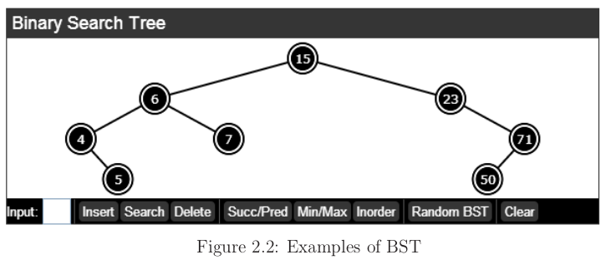
Balanced Binary Search Tree (BST): C++ STL map/set
1. Balanced Binary Search Tree (BST): C++ STL map/set
The BST is one way to organize data in a tree structure. In each subtree rooted at x, the following BST property holds: Items on the left subtree of x are smaller than x and items on the right subtree of x are greater than (or equal to) x.
In the worst case, only O(log n) operations are required in a root-to-leaf scan . However, this only holds if the BST is balanced.

Slide 4
C++ STL map/set or multimap/multiset
Map
Maps are associative containers that store elements formed by a combination of a key value and a mapped value, following a specific order.
In a map, the key values are generally used to sort and uniquely identify the elements.
Multiple-key map
Key value and a mapped value, following a specific order, and where multiple elements can have equivalent keys.
Set
In a set, the value of an element also identifies it (the value is itself the key, of type T), and each value must be unique.
The value of the elements in a set cannot be modified once in the container (the elements are always constant), but they can be inserted or removed from the container.
Multiple set
Multisets are containers that store elements following a specific order, and where multiple elements can have equivalent values

Slide 5
C++ STL map/set or multimap/multiset
Map/Set Member functions
Iterators:
begin Return iterator to beginning
end Return iterator to end
rbegin Return reverse iterator to reverse beginning
rend Return reverse iterator to reverse end
Capacity:
empty Test whether container is empty
size Return container size
max_size Return maximum size
Element access:
operator[] Access element
at Access element
Modifiers:
insert Insert elements
erase Erase elements
clear Clear contents
Operations:
find Get iterator to element
count Count elements with a specific key
lower_bound Return iterator to lower bound
upper_bound Return iterator to upper bound
equal_range Get range of equal elements

Slide 6
C++ STL map/set
Example Map
#include <bits/stdc++.h>
using namespas std;
int main (){
map<char, int> mymap;
mymap.insert ( pair<char,int>('a',100) ); // first insert function version (single parameter):
mymap.insert ( pair<char,int>('z',200) ); // first insert function version (single parameter):
mymap['b'] = 300 // second insert function version (with hint position):
map<char,int> anothermap;
anothermap.insert(mymap.begin(),mymap.end()); // third insert function version (range insertion):
cout << “Mymap contains:\n"; // showing contents:
for (auto it=mymap.begin(); it!=mymap.end(); ++it)
cout << it->first << " => " << it->second << '\n';
return 0;
}
Output:
mymap contains: a => 100 b => 300 c => 400

Slide 7
C++ STL map/set
Example Set
#include <bits/stdc++.h>
using namespas std;
int main (){
set<int> myset;
myset.insert (100); myset.insert (200); myset.insert (300);
cout << "myset contains:";
for (auto it=myset.begin(); it!=myset.end(); ++it)
cout << ' ' << *it << '\n';
myset.clear();
myset.insert (1101); myset.insert (2202);
cout << "myset contains:";
for (auto it : myset)
cout << ' ' << it << ‘\n’;
return 0;
}
Output:
myset contains: 100 200 300 myset contains: 1101 2202

Slide 8
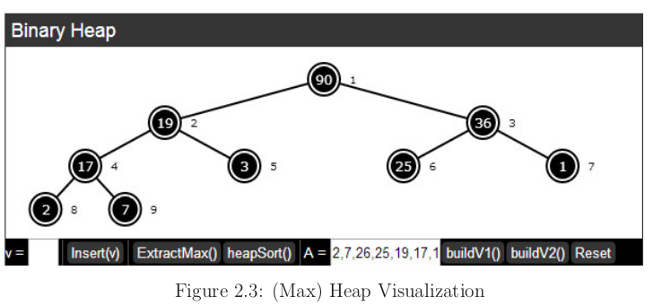
Heap: C++ STL priority queue
2. Heap: C++ STL priority queue
The heap is another way to organize data in a tree.
The (Binary) Heap is also a binary tree like the BST, except that it must be a complete tree.
Complete binary trees can be stored efficiently in a compact 1-indexed array of size n + 1, which is often preferred to an explicit tree representation.
For example, the array A = {N/A, 90, 19, 36, 17, 3, 25, 1, 2, 7} is the compact array representation of Figure 2.3 with index 0 ignored.

Slide 9
Heap: C++ STL priority queue
Priority queues are a type of container adaptors, specifically designed such that its first element is always the greatest of the elements it contains, according to some strict weak ordering criterion.
Member functions
empty Test whether container is empty
size Return size
top Access top element
push Insert element
emplace Construct and insert element
pop Remove top element
swap Swap contents

Slide 10
Heap: C++ STL priority queue
#include <bits/stdc++.h> // Example for priority queue
using namespas std;
int main (){
priority_queue<int> mypq;
mypq.push(30);
mypq.push(100);
mypq.push(25);
mypq.push(40);
cout << "Popping out elements...";
while (!mypq.empty()){
cout << ' ' << mypq.top();
mypq.pop();
}
cout << '\n';
return 0;
}
Output:
Popping out elements... 100 40 30 25

Slide 11
Heap: C++ STL priority queue
#include <bits/stdc++.h> // Example for priority queue
using namespas std;
int main (){
priority_queue<int> foo,bar;
foo.push (15); foo.push(30); foo.push(10);
bar.push (101); bar.push(202);
foo.swap(bar);
cout << "size of foo: " << foo.size() << '\n';
cout << "size of bar: " << bar.size() << '\n';
return 0;
}
Output:
size of foo: 2 size of bar: 3

Slide 12
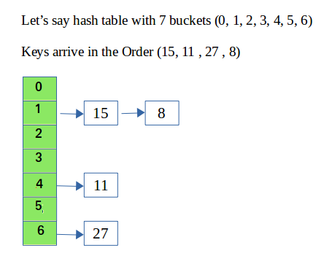
Hash Table: C++11 STL unordered map
3. Hash Table: C++11 STL unordered_map
The Hash Table is another non-linear data structure, but we do not recommend using it in programming contests unless absolutely necessary.
Unordered maps are associative containers that store elements formed by the combination of a key value and a mapped value, and which allows for fast retrieval of individual elements based on their keys.

Slide 13
Hash Table: C++11 STL unordered map
#include <bits/stdc++.h>
using namespas std;
int main (){
unordered_map<string, string> mymap;
// populating container:
mymap["U.S."] = "Washington"; mymap["U.K."] = "London"; mymap["France"] = "Paris";
mymap["Russia"] = "Moscow"; mymap["China"] = "Beijing"; mymap["Germany"] = "Berlin";
mymap.erase ( mymap.begin() ); // erasing by iterator
mymap.erase ("France"); // erasing by key
mymap.erase ( mymap.find("China"), mymap.end() ); // erasing by range
// show content:
for ( auto x: mymap )
cout << x.first << ": " << x.second << endl;
return 0;
}
Possible output:
Germany: Berlin Russia: Moscow U.S.: Washington U.K.: London

Slide 14
Hash Table: C++11 STL unordered map
Write a program that print the list of unique 10 integers occuring in the input sequence, along with the number of occurences of each.
For example input: 3 1 2 2 1 3 5 3 3 2
Output:
3 4
1 2
2 3
5 1
#include <bits/stdc++.h>
using namespace std;
map<int, int> m;
Int a, i=0;
int main(){
while(i<10) {
cin>>a;
m[a]++;
i++;
}
for(auto x:m)
cout << x.first << “ “ << x.second<< “\n”;
}
Solution:

